Slide 1
Motion G
Culture
2024/07

Slide 2
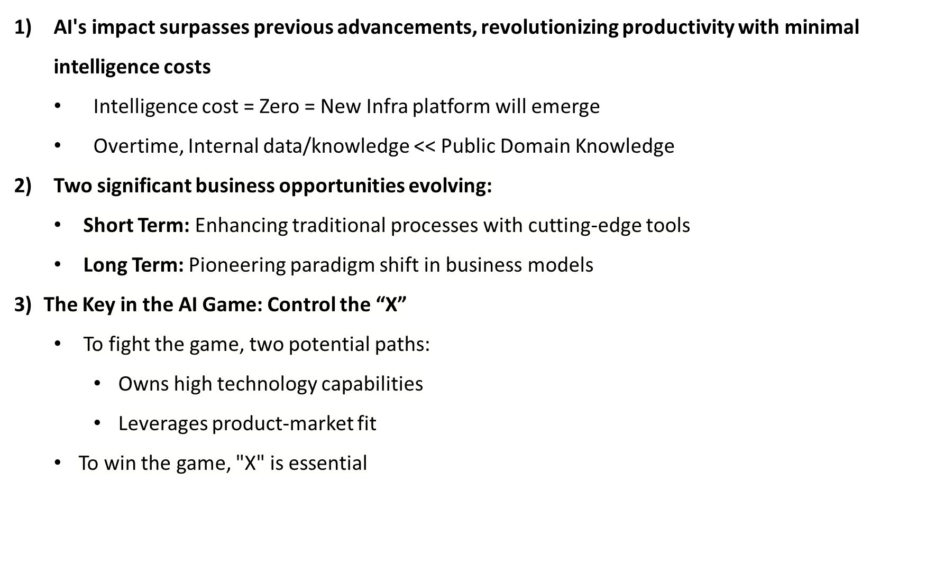

Slide 3
New Culture for the New AI Game
Building on Zero Intelligence Costs: Unleashing and leverage advanced technology to create unprecedented value.
Scale Determines Success: Pushing the boundaries of knowledge and capabilities, daring to innovate, consistently creating customer value beyond expectations to drive scalability.
Future Competition: Engaging in comprehensive international competition with leading global enterprises, relying on a diverse global team united by shared beliefs and unified principles to chart a course for future success.

Slide 4
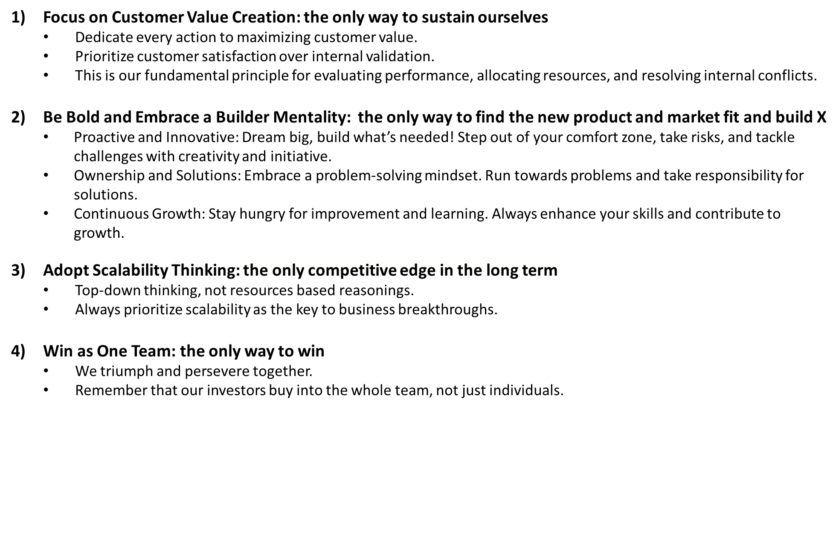

Slide 5
Detailed Guideline

Slide 6
Focus on Customer Value Creation: the only way to sustain ourselves
  Empathy and customer obsession:
    Lasting principles over short-term technology.
    Strive for customer validation, not just internal approval.
    Commitment to fighting for customer value.
  Deep Customer Engagement:
    Regular customer visits (Avoid developing in isolation).
    Thoroughly understand and address their needs: fast horse vs. car analogy.
  Key Practice areas:
    Hiring, Evaluation, and Promotion.
    Conflict Resolution.

Slide 7
Be Bold and Embrace a Builder Mentality: the only way to find the new product and market fit and build X
  Dare to Dream Big: Challenge conventional beliefs, dream big, to seize new opportunities.
  Embrace Risk and Initiative: Step out of your comfort zone, take risks, and approach challenges with creativity.
  Ownership and Solutions: Embrace a proactive problem-solving mindset. Run towards problems and take responsibility for solutions.
  Continuous Growth: Stay hungry for improvement and learning. Always strive for personal and professional growth. Continuously enhance skills to drive organizational development.
  Future-Focused Builder: Why Me? I am the builder, and only I can build the future.
  Navigate Ambiguity: Confidently handle uncertainty and see setbacks as valuable learning opportunities.
  Courageous Persistence: Overcome obstacles, defy skepticism, and pioneer new paths with courage and vulnerability.

Slide 8
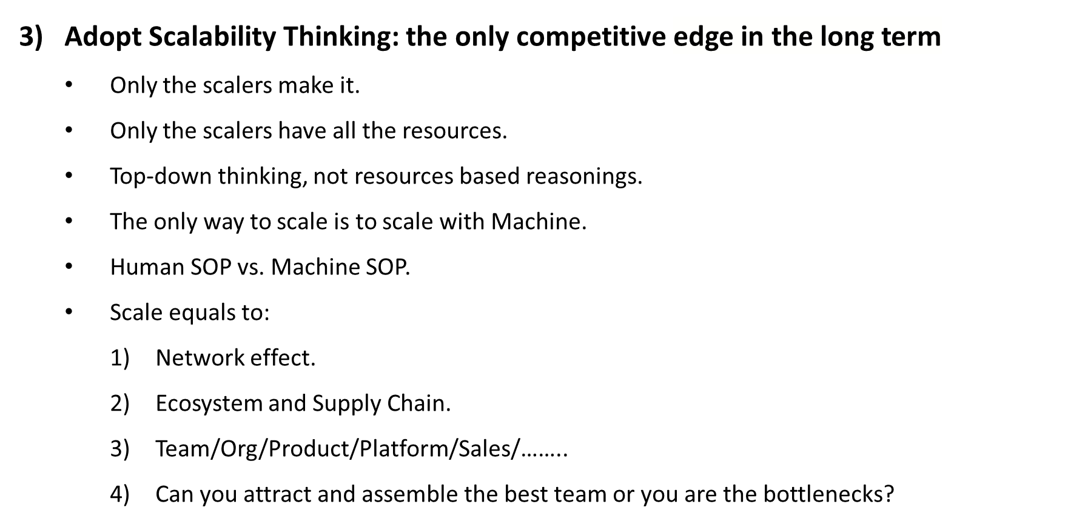

Slide 9
4) Win as One Team: the only way to win
  We triumph or perish together, at the end.
  Run toward the fire for the teammate.
  The investors invest in the whole team, not part of the team.
  No complaints; encourage each other to become a builder.
  Embrace trust, transparency, and candid communication.
  Uphold high standards for each other.

Slide 10
Motion G
文化
2024/07

Slide 11
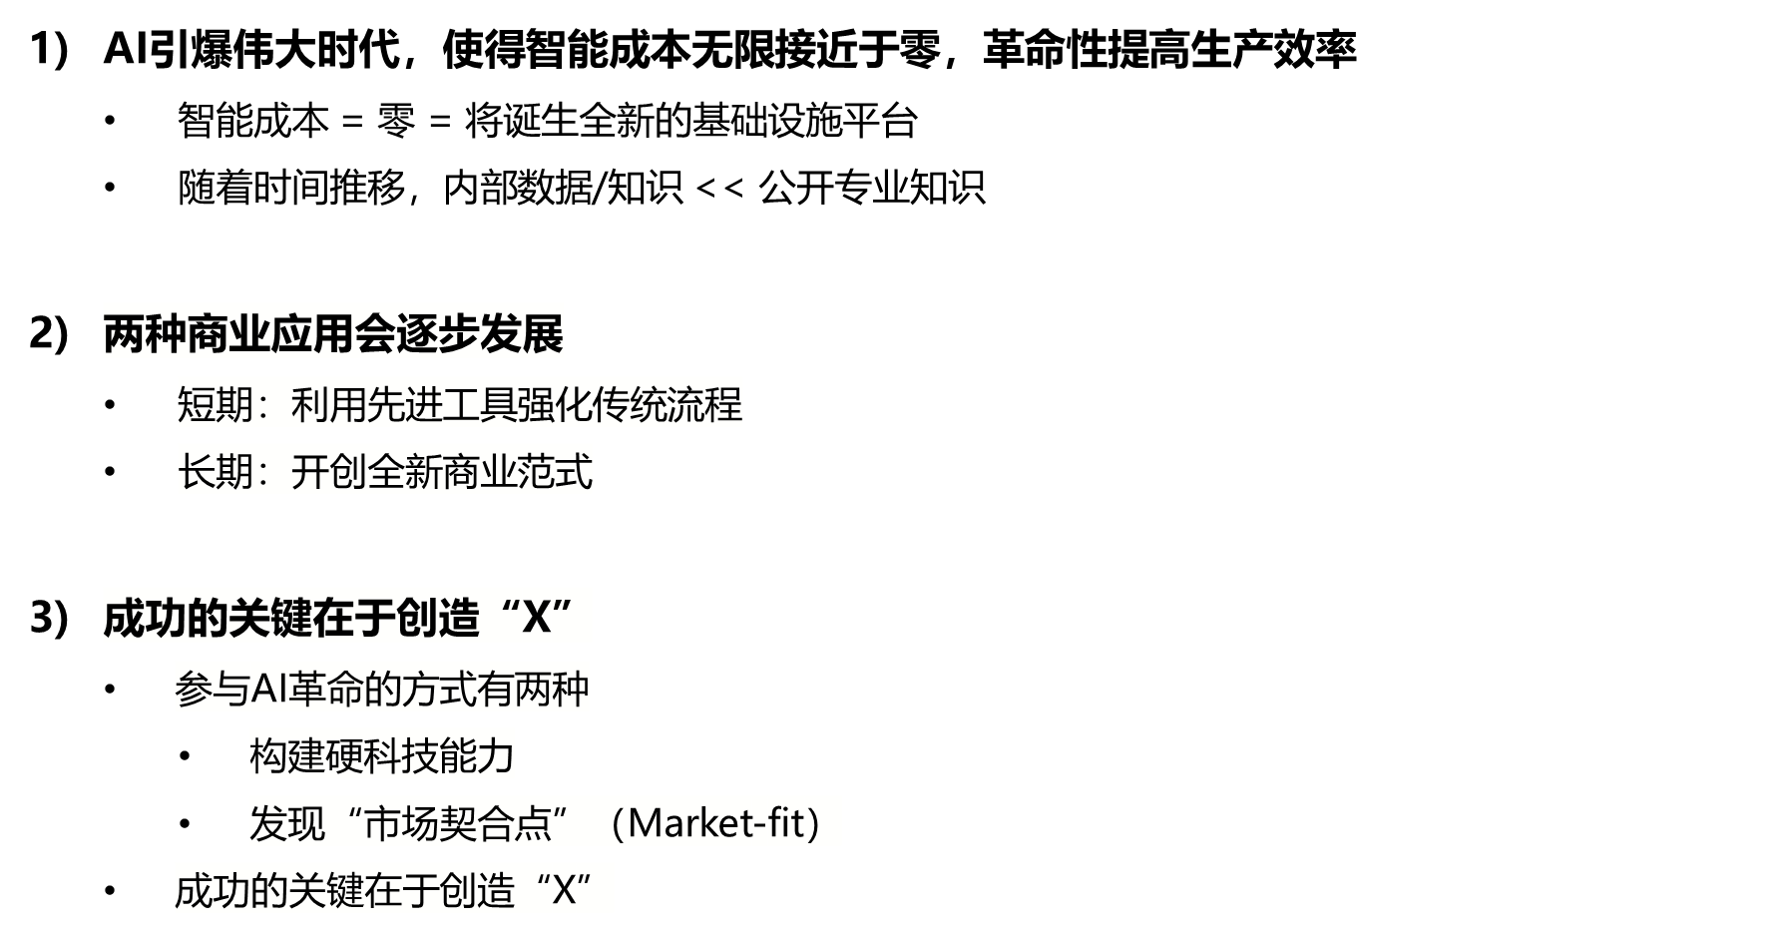

Slide 12
新时代，新文化：
AI革命引爆伟大时代，使得智能成本无限接近于零。这让我们有机会利用先进技术，创造前所未有的价值。
成败的关键在于能否驱动规模化增长。我们必须全方位拓展知识和能力边界，大胆创新，始终坚持创造客户价值，超越客户预期，驱动规模化增长。
未来的竞争，将是与国际领先企业的全面竞争。国际化竞争依靠多元化的全球团队，唯有打造共同信念和统一原则，方可同舟共济，赢得未来。

Slide 13
1）坚持“客户价值”为中心：唯一生存路径
  致力于最大化创造客户价值
  客户满意度高于内部认可
  客户满意度是我们绩效评估、资源分配、冲突处理的根本原则
2）勇敢尝试，成为筑梦者：唯一创造“X”的方法
  勇于创新：大胆梦想，勇敢尝试
  承担责任：跳出舒适圈，直面问题，解决问题
  持续成长：保持饥饿，坚持学习，持续成长
3）打造“规模化增长”思维：唯一竞争优势
  自上而下思考，放弃资源思维
  始终将规模化增长作为业务突破的关键
4）同舟共济，胜则共荣，败亦同担：唯一获胜之路
  作为一个团队，共担风雨，共赢未来
  铭记在心：投资者投资的是整个团队

Slide 14
文化细则示例
附件

Slide 15
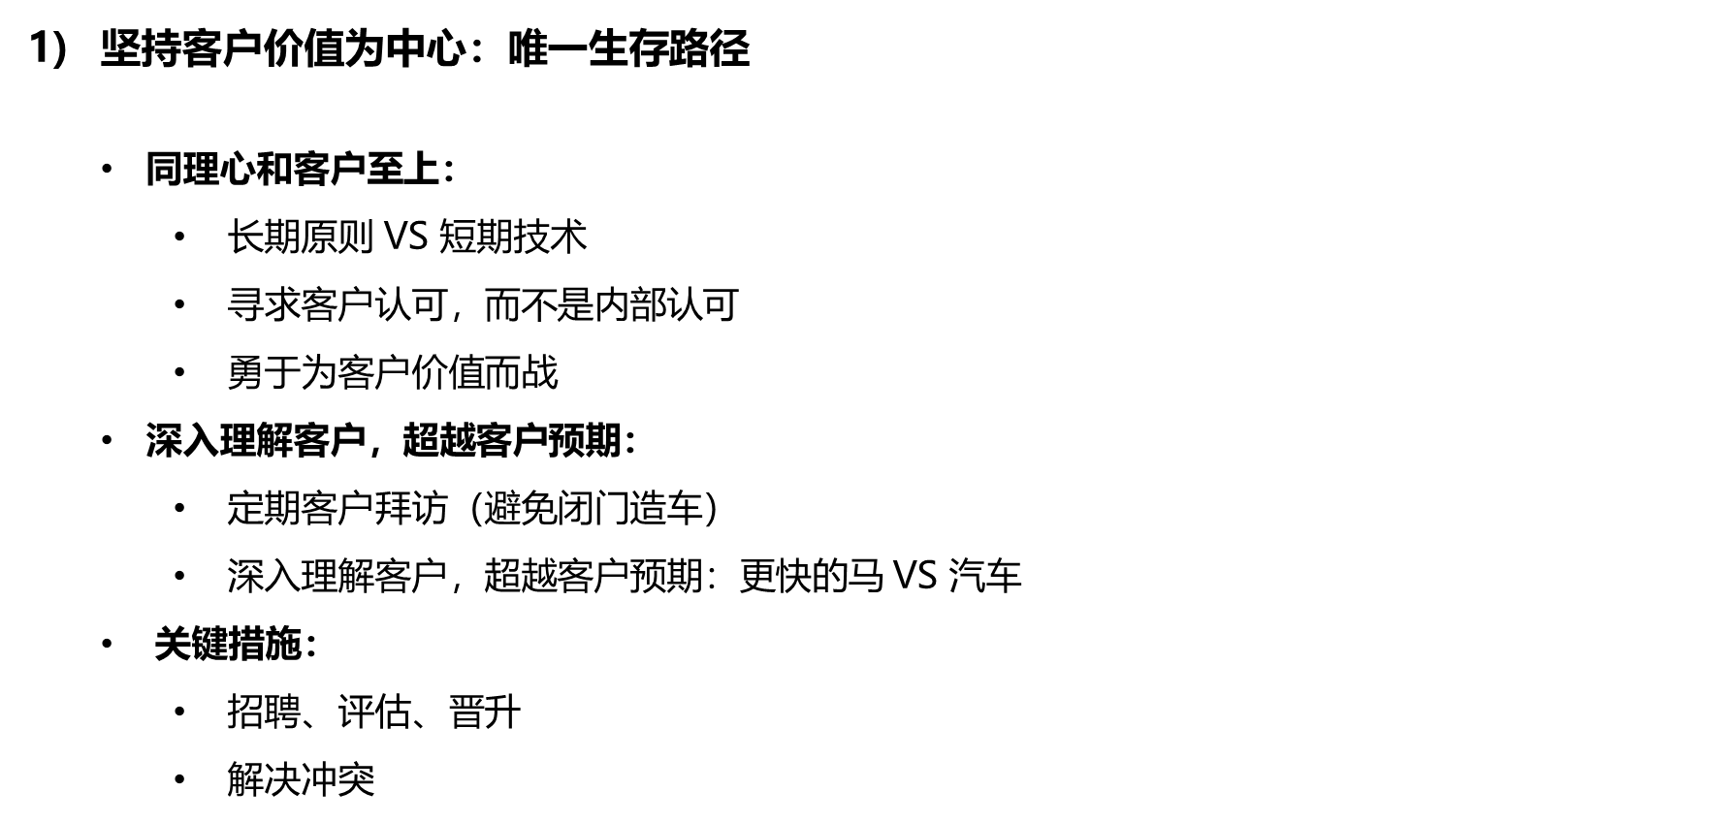

Slide 16
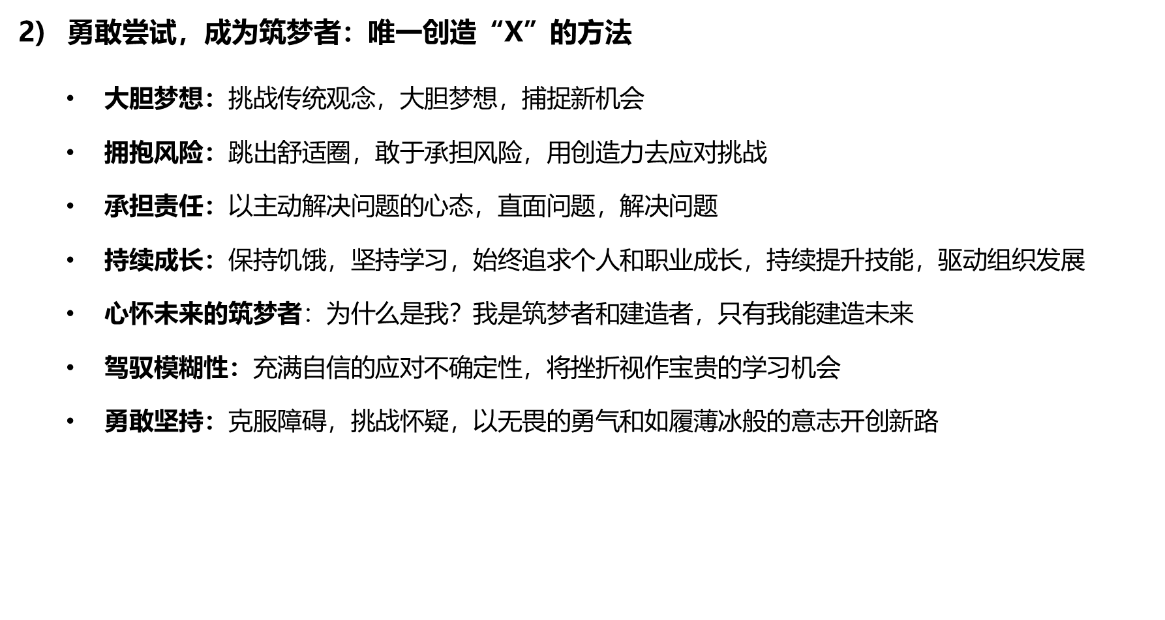
文化 -自我驱动的根本原则

Slide 17
文化 -自我驱动的根本原则
打造规模化思维：唯一竞争优势
  只有规模化思维的人才能成功
  只有规模化思维的人才能拥有资源
  自上而下思考，放弃资源思维
  规模化的唯一方式是利用机器实现规模化
  传统人为 SOP VS 机器 SOP
  规模化等于：
    网络效应
    生态体系和供应链
    团队/组织/产品/平台/销售/……
    你可以吸引和组建最牛的团队吗？自己是瓶颈吗？

Slide 18
文化 -自我驱动的根本原则
同舟共济，胜则共荣，败亦同担：唯一获胜之路
  最终，我们将一起胜利或失败
  为团队赴汤蹈火
  投资人投资的是整个团队
  不要抱怨，要鼓励彼此成为筑梦者和建造者
  信任和透明，坦诚沟通
  相互高标准要求

Slide 19


